Slide 1


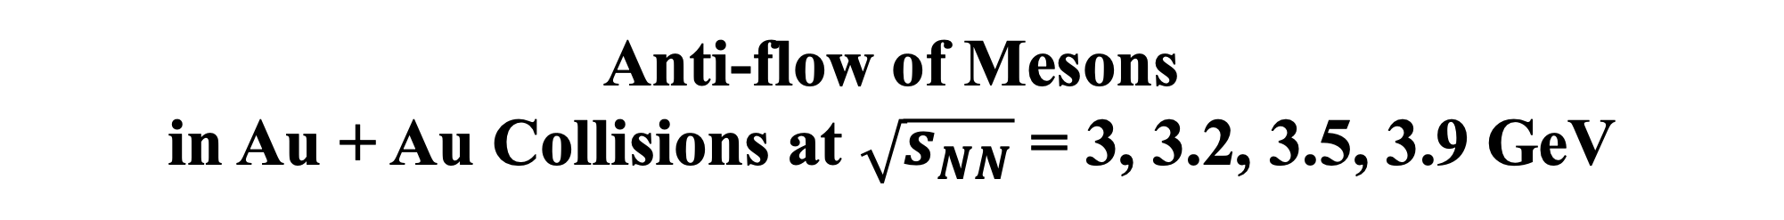
Anti-flow of Mesons
in Au + Au Collisions at $\sqrt{s_{NN}}$ = 3, 3.2, 3.5, 3.9 GeV
Zuowen Liu
Central China Normal University

Slide 2
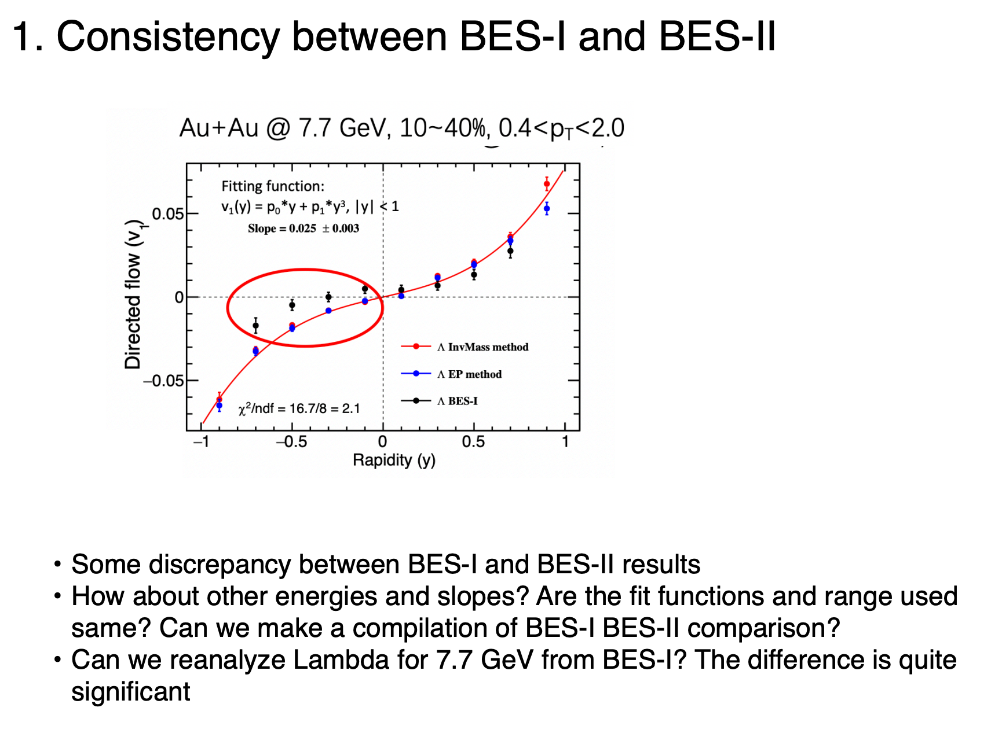
Question 1
Fitting functions: v₁(y) = p₀*y
Rapidity | BESI | BESII
(0, 0.8) | 0.0315±0.00380 | 0.0458±0.00226
(-0.8, 0) | 0.0121±0.00406 | 0.0384±0.00196
(-0.8, 0.8) | 0.0225±0.00278 | 0.0415±0.00148
2) Fitting functions are different:
BES-I: v₁(y) = p₀*y , |y| < 0.8
BES-II: v₁(y) = p₀*y + p₁*y³ , |y| < 1

Slide 3
Au+Au @ 14.6 GeV, 10~40%, 0.4<pT<2.0

Slide 4
Au+Au @ 19.6 GeV, 10~40%, 0.4<pT<2.0

Slide 5
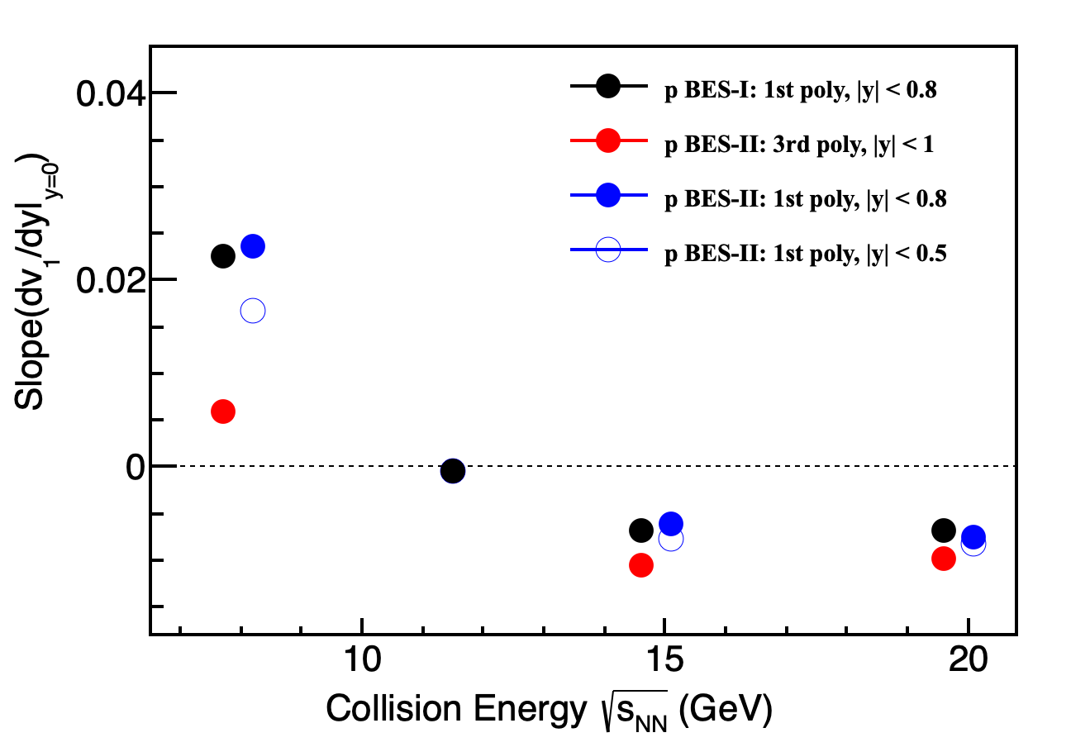
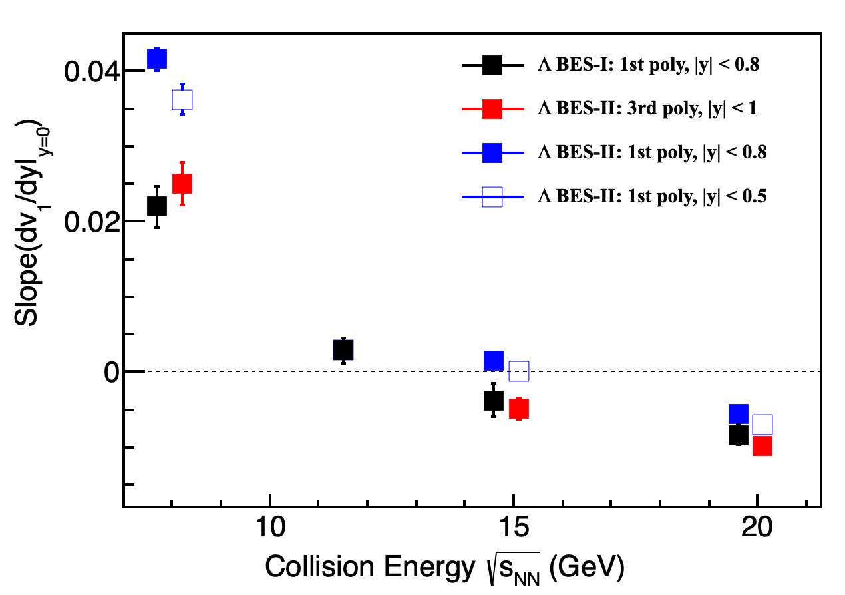
p/𝛬 v₁ Slope: BES-I vs BES-II
BESI: 1st order poly: v₁(y) = p₀*y
3rd order poly: v₁(y) = p₀*y + p₁*y³
Note: The error is statistic error only.
Proton v₁ slopes: BESI and BESII consistent with same fitting function and range v₁(y) = p₀*y (|y| < 0.8)
𝛬 v₁ slopes: not consistent as mentioned in slide 2
The v₁ slopes depend on the fitted rapidity range.
Notes:
This slide show v1 slopes extracted by different function and different fitting range.

Slide 6
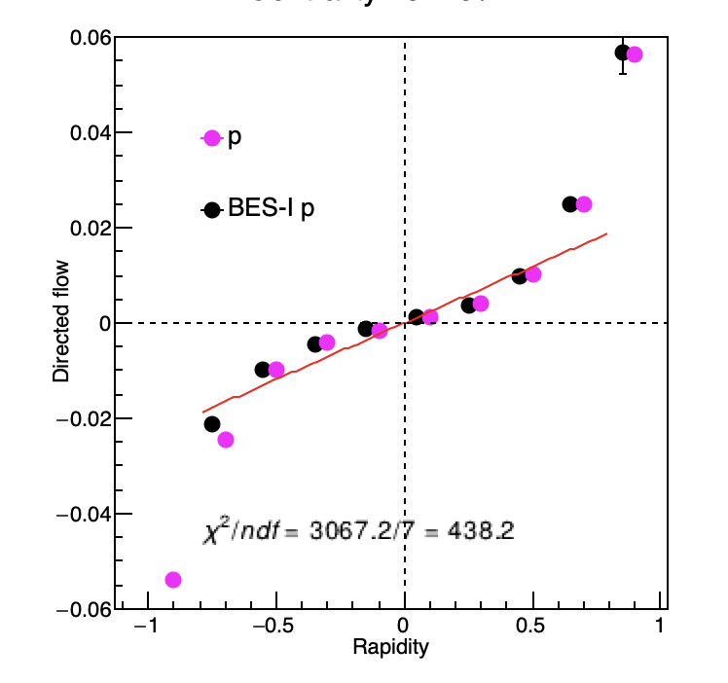
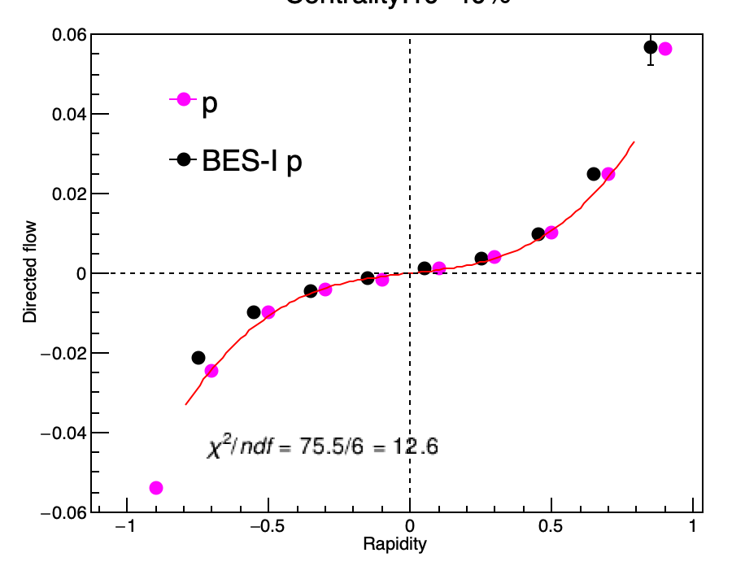
Au+Au @ 7.7 GeV, 10-40%, 0.4<p_{T}<2.0
Fitting function:
v₁(y) = p₀*y + p₁*y³, |y| < 0.8
Fitting function:
v₁(y) = p₀*y , |y| < 0.8
Slope = 0.00749 ± 3.28703e-04
Slope = 0.0236 ± 1.53749e-04
BES-I slope:
0.022534 ±
8.63638e-04
BESI and BESII consistent with same fitting function and range
There is an obvious difference for slopes determined by different functions
(in the analysis note of BESI paper, people claimed the v1 slope does not strongly depends on the fitting functions)
Notes:
From my site, abundant statistics from BES-II； theoretically, 3rd ploy term should be taken into consideration to describe far-rapidity data.

Slide 7
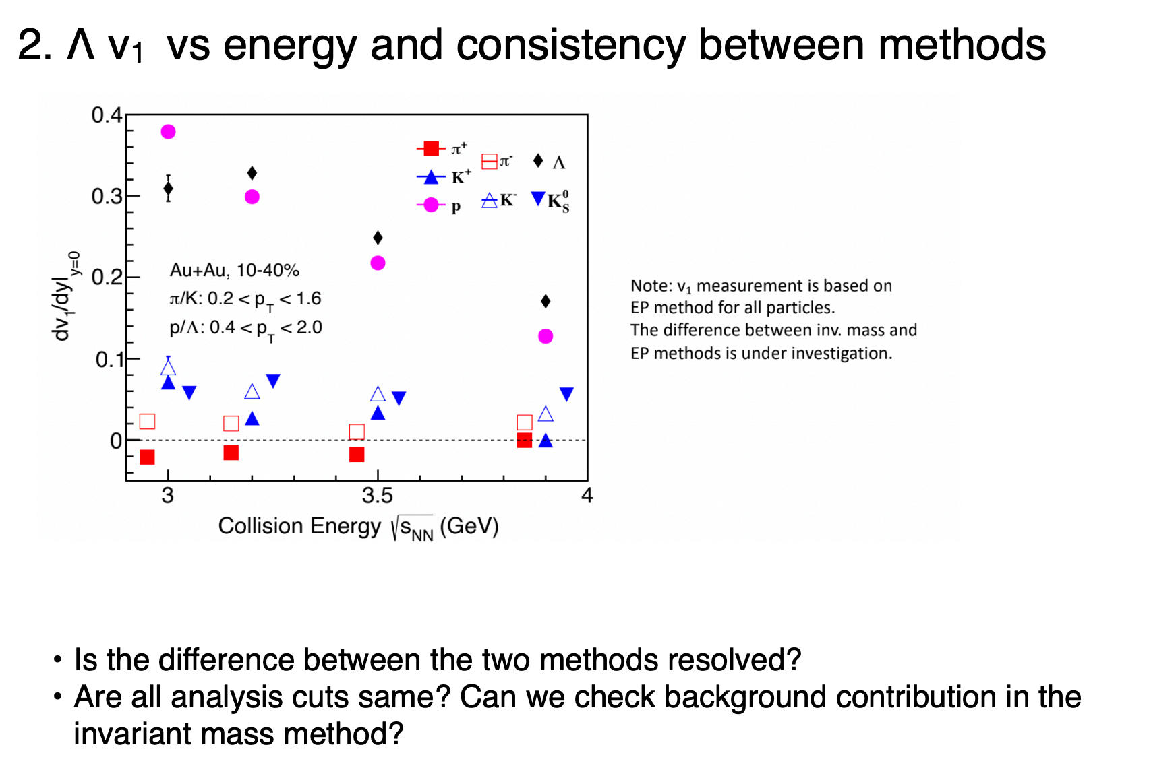
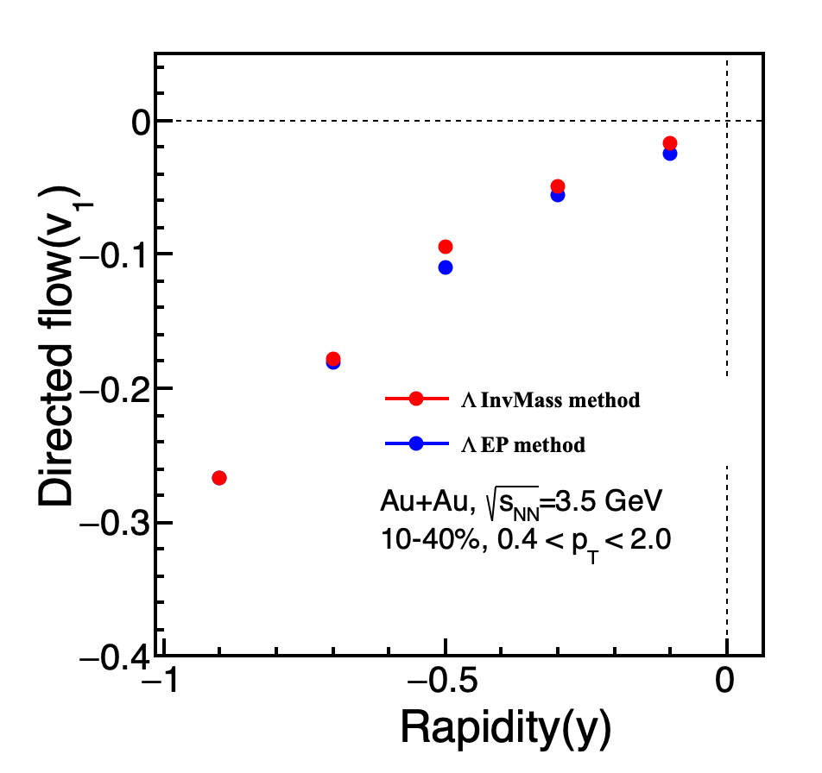
Question 2
With eff. correction

Slide 8
Background looks well controlled.
Still under investigation

Slide 9
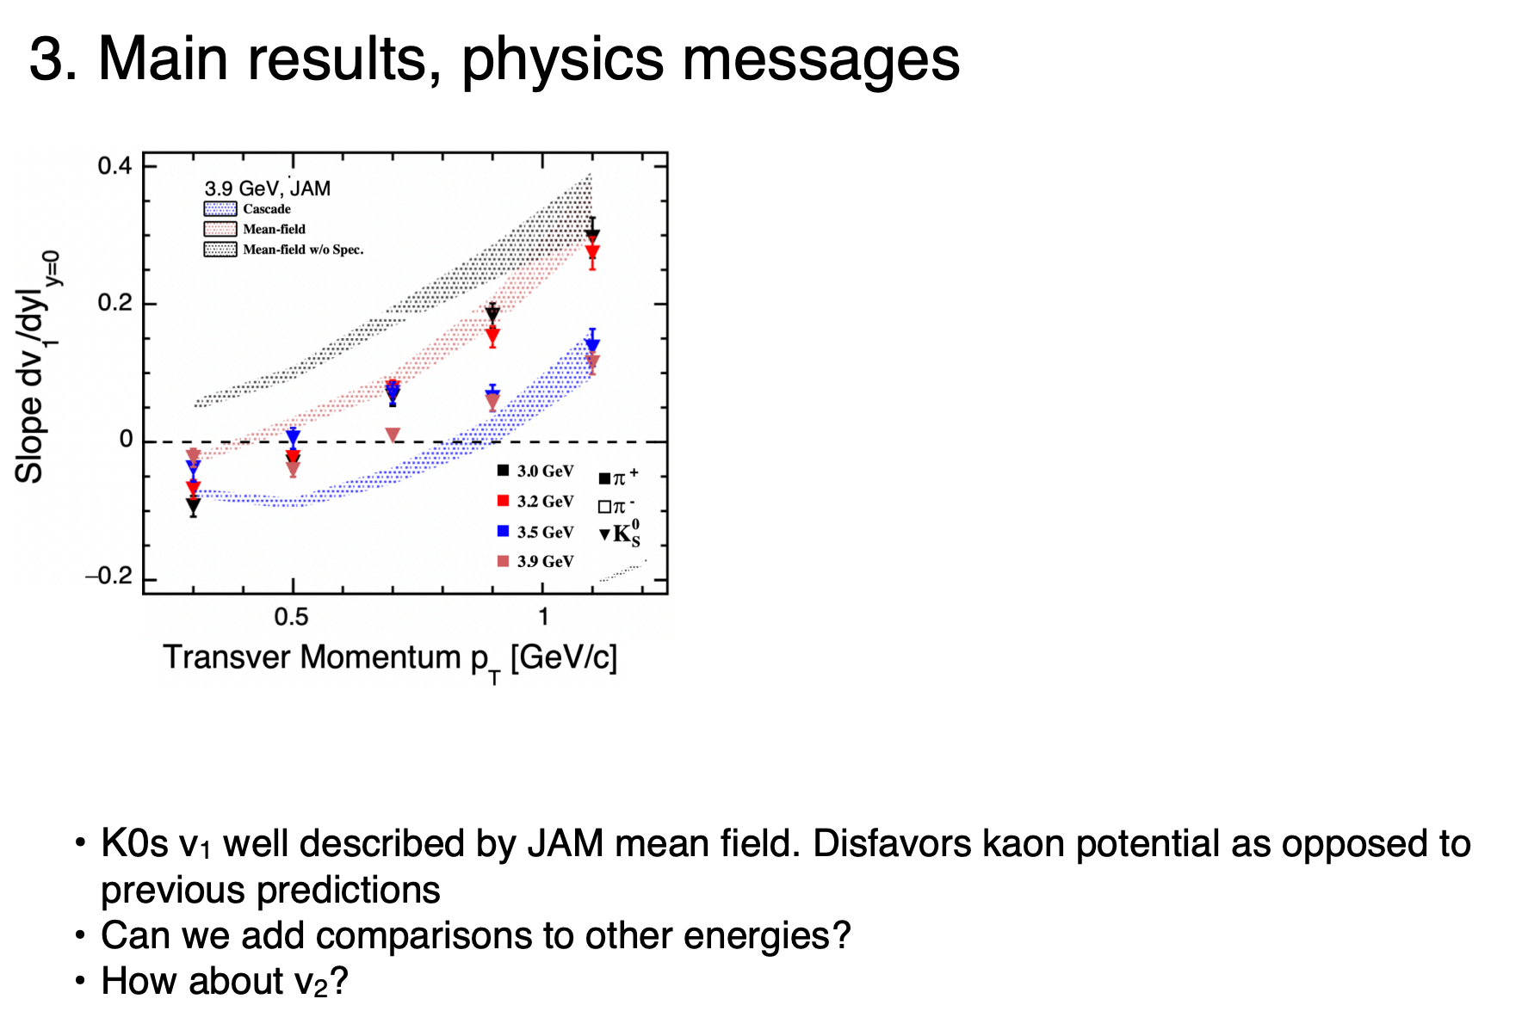
Question 3
Mean-field + spectator well describes data at low pT
Mean-field effect in JAM too strong at high pT?
For v2, best description with RQMD/RMF mode

Slide 10
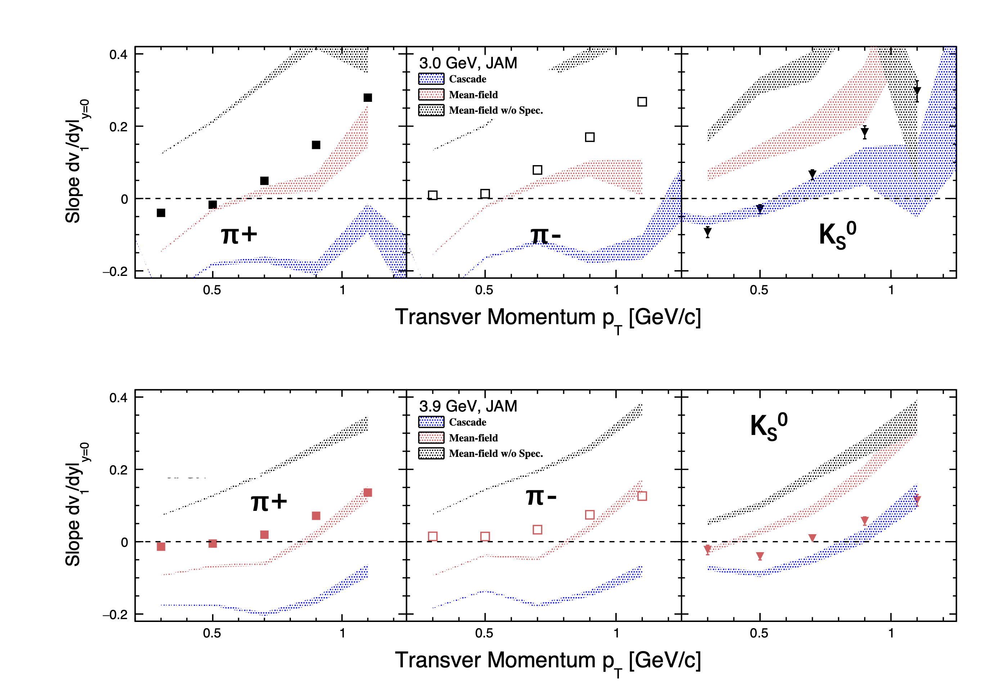

Slide 11
JAM Setup
JAM
Version: 2.1
Data: ~5 M
b) Mean Field
RQMDv/MS2
RQMDv/MH2
RQMD/RMF
Cascade
Cascade(default)
Cascade w/o spectator
Note:
v: Lorentz vector potentials
M: Lorentzian-type Momentum dependent potential
H/S: The nuclear incompressibility K = 380 MeV (Hard) or 210 MeV (Soft).
RMF: Relativistic Mean Field
*Yasushi Nara and Akira Ohnishi, PRC, 105, 014911 (2022)
arXiv:2004.05550v2

Slide 12
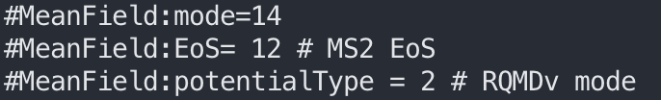
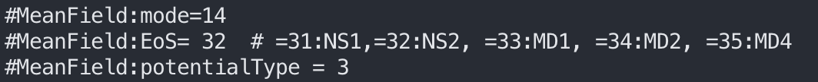
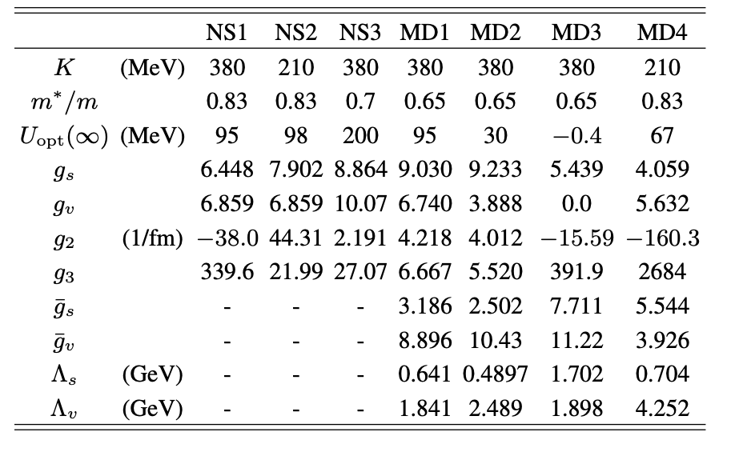
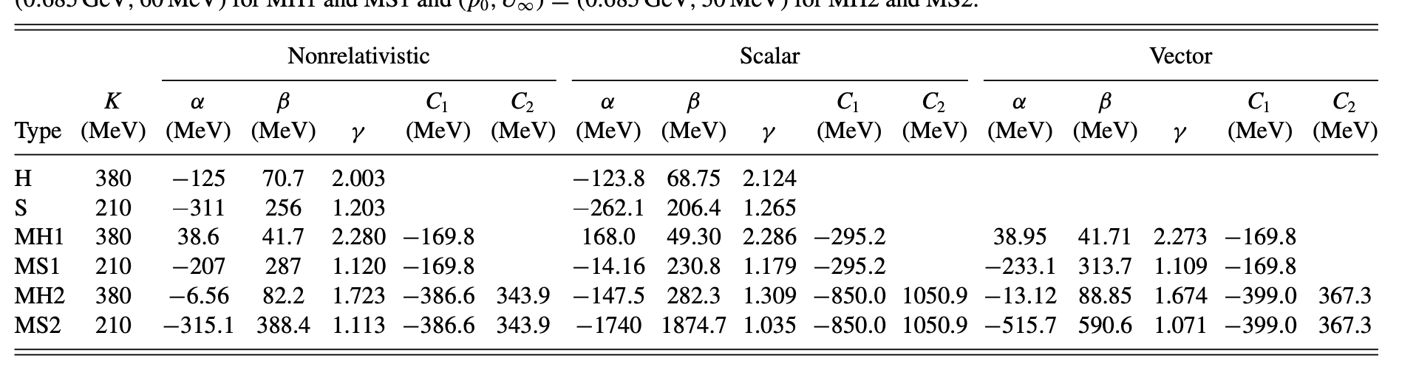
JAM Setup
*Yasushi Nara and Akira Ohnishi, PRC, 105, 014911 (2022)
arXiv:2004.05550v2
RQMDv/MS2
3. RQMD/RMF
potentialType:
=0:Non-relativistic
=1:Skyrme scalar
=2:Skyrme vector
=3:scalar + nonlinear vector potential (sigma-omega model)
NS: Nonlinear Scalar interaction
MD: Momentum-Dependent potentials

Slide 13
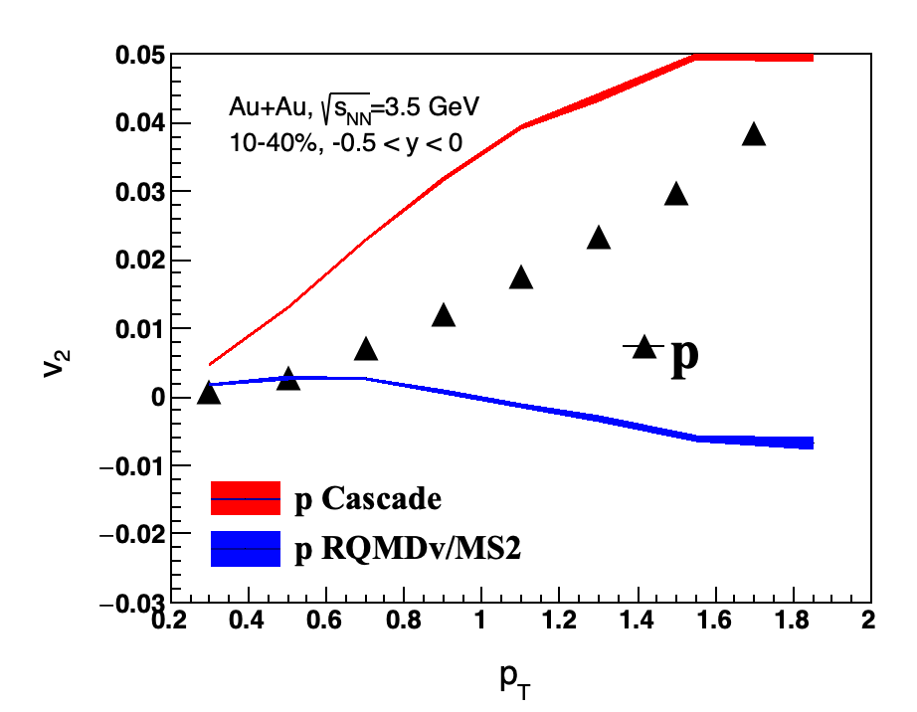
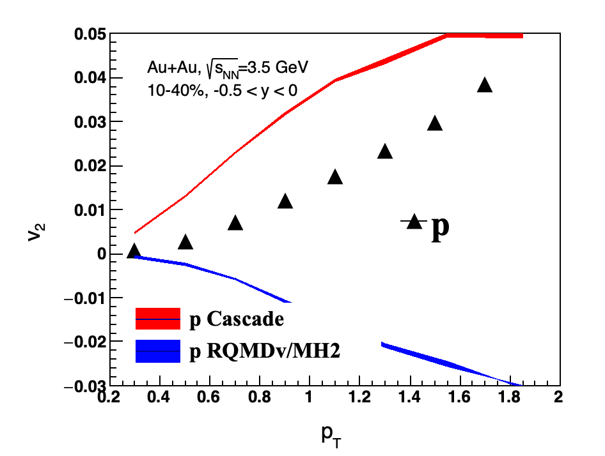
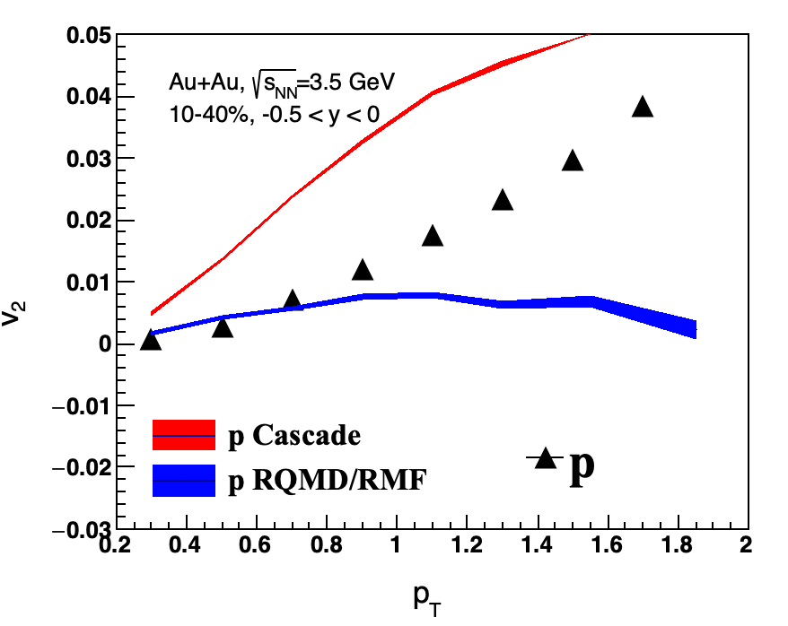
RQMDv/MS2
RQMDv/MH2
RQMD/RMF
BEST
BEST

Slide 14
Comparison with JAM2
RQMDv/MS2
Yasushi Nara, Akira Ohnishi. Phys. Rev. C. 105, 014911(2022)

Slide 15
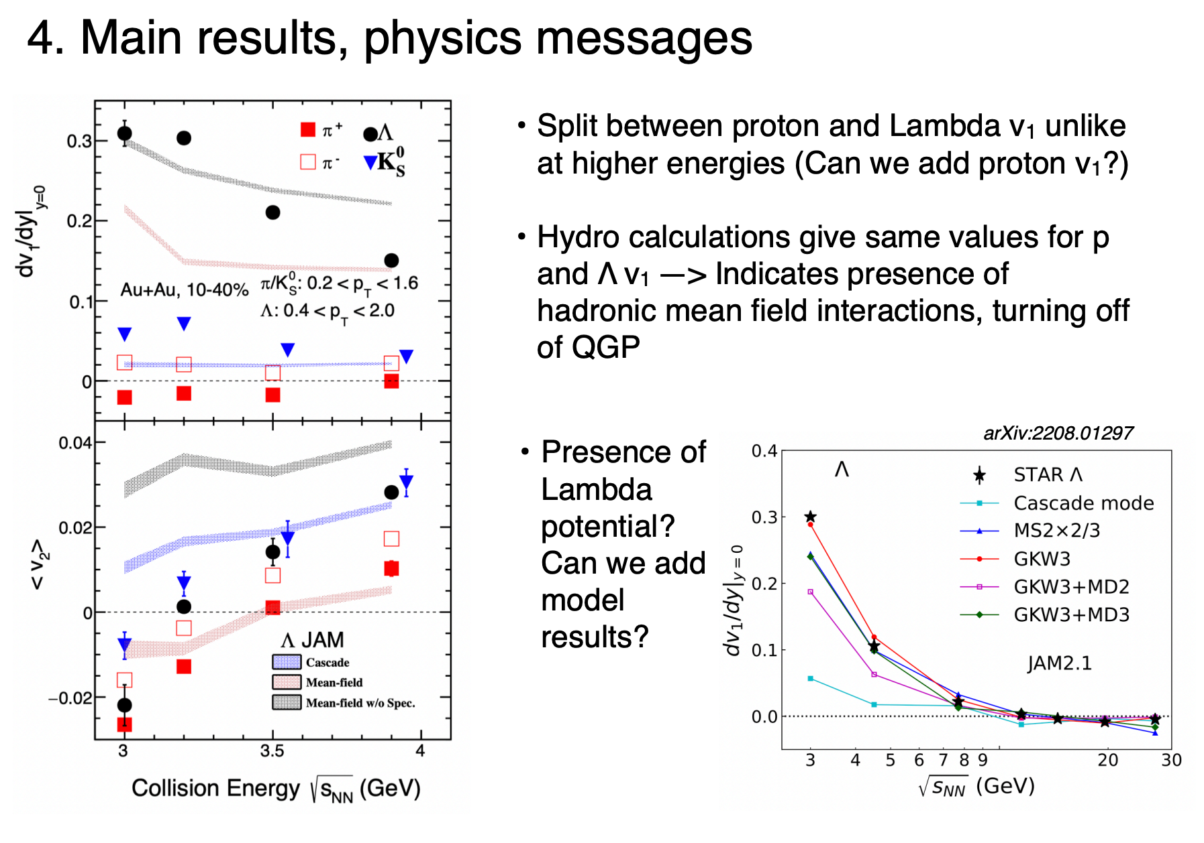
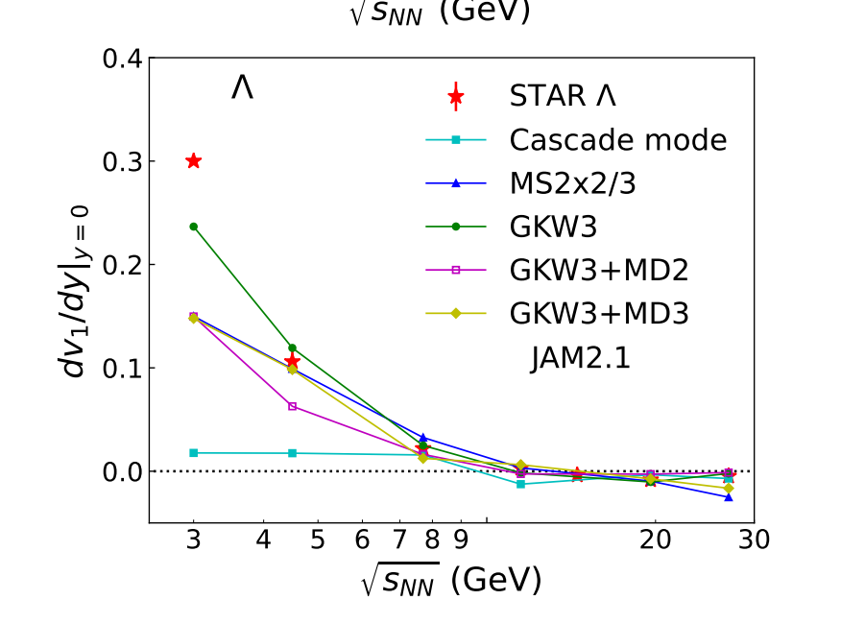
Question 4
No, acceptance issue
Proton can not be done within p_{T}(0.4, 2.0) GeV/c and Y(-1, 0)
3) Working on GKW3(lambda potential with 3-body interaction)
arXiv:2208.01297v2
2208.01297v1

Slide 16
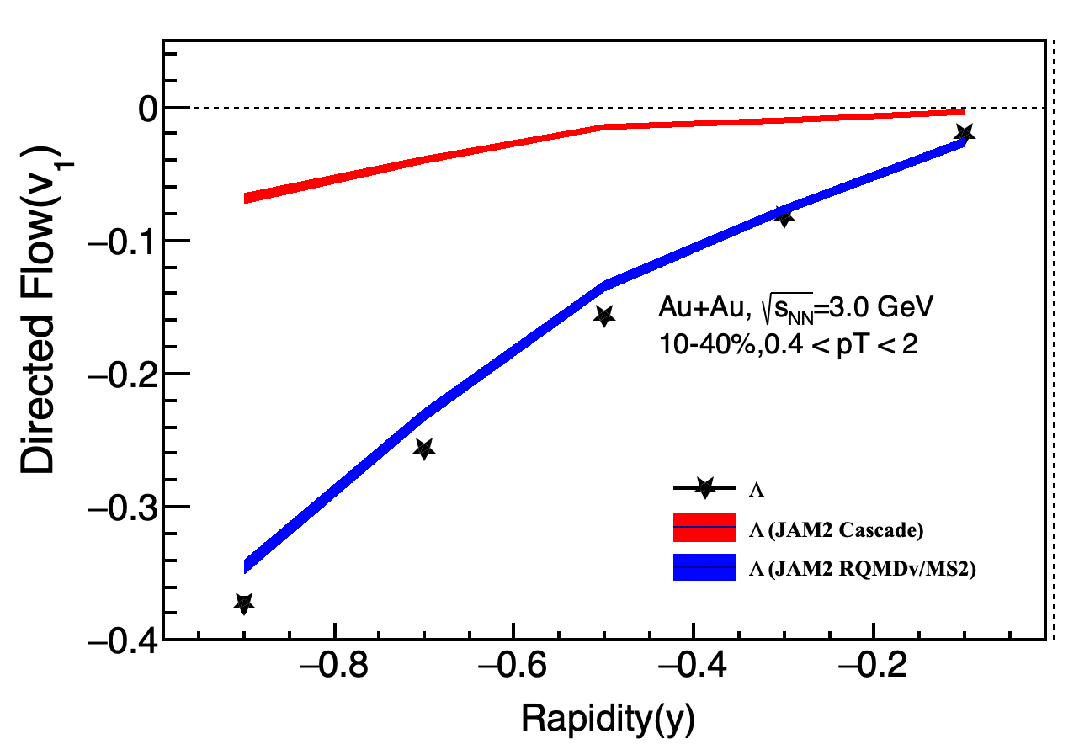
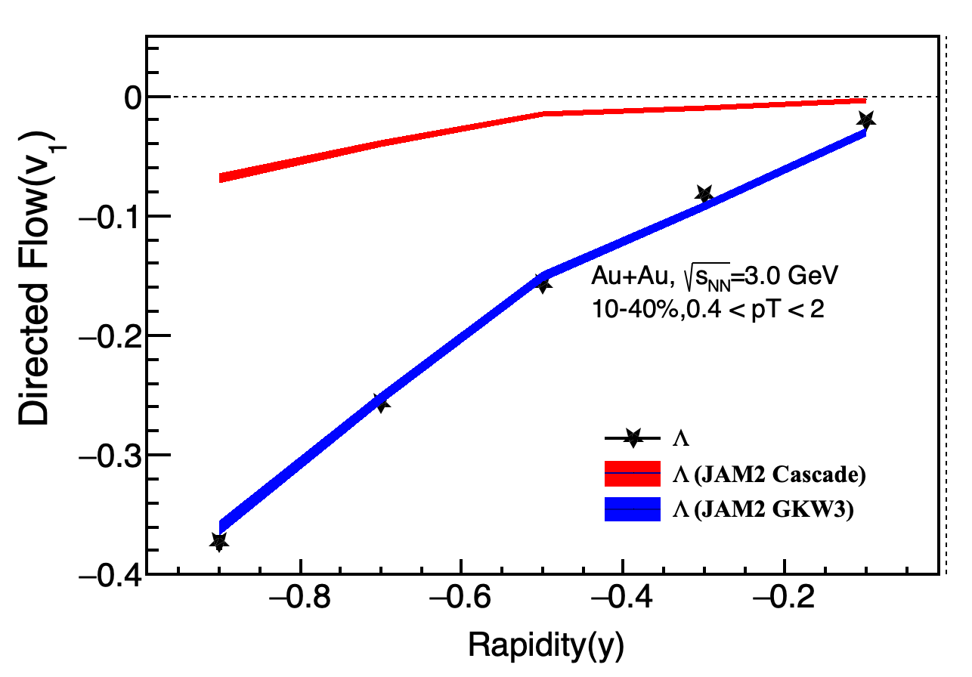
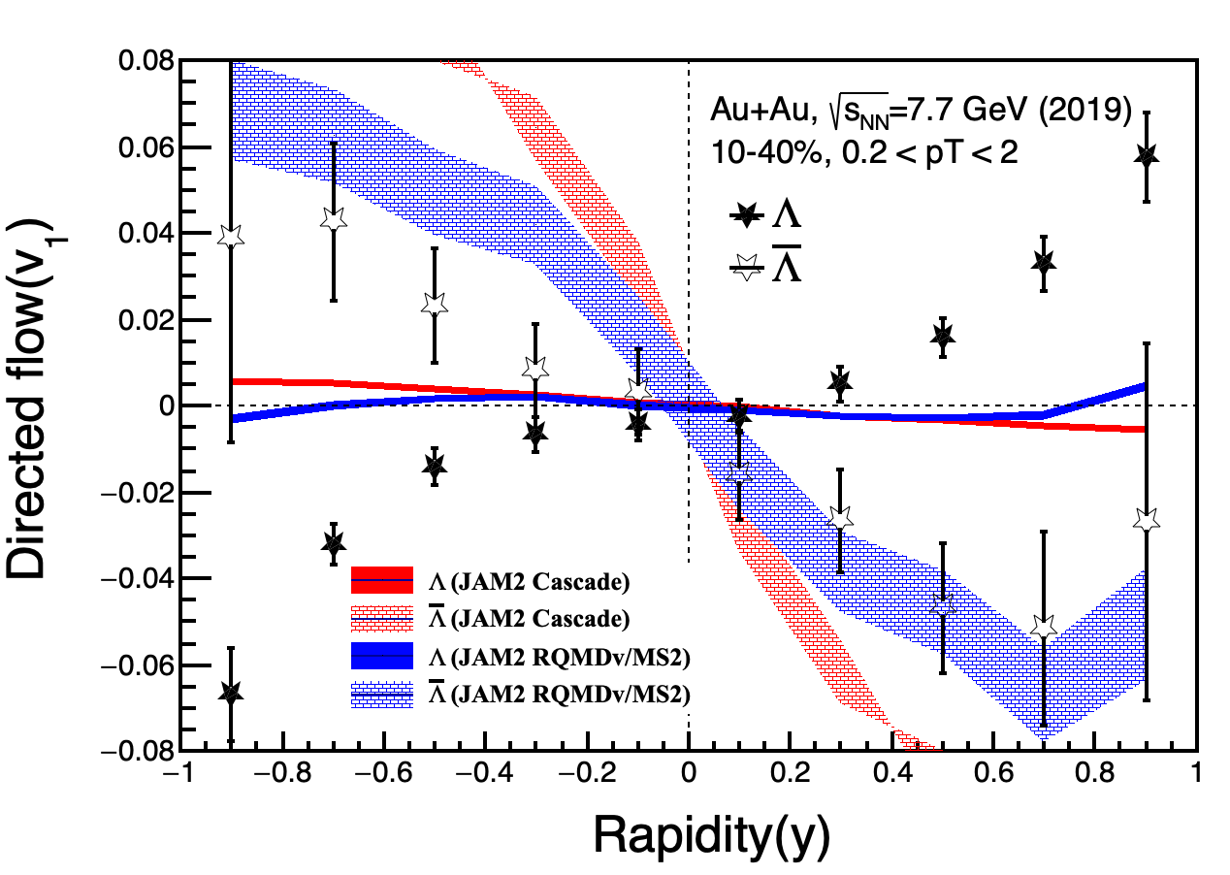
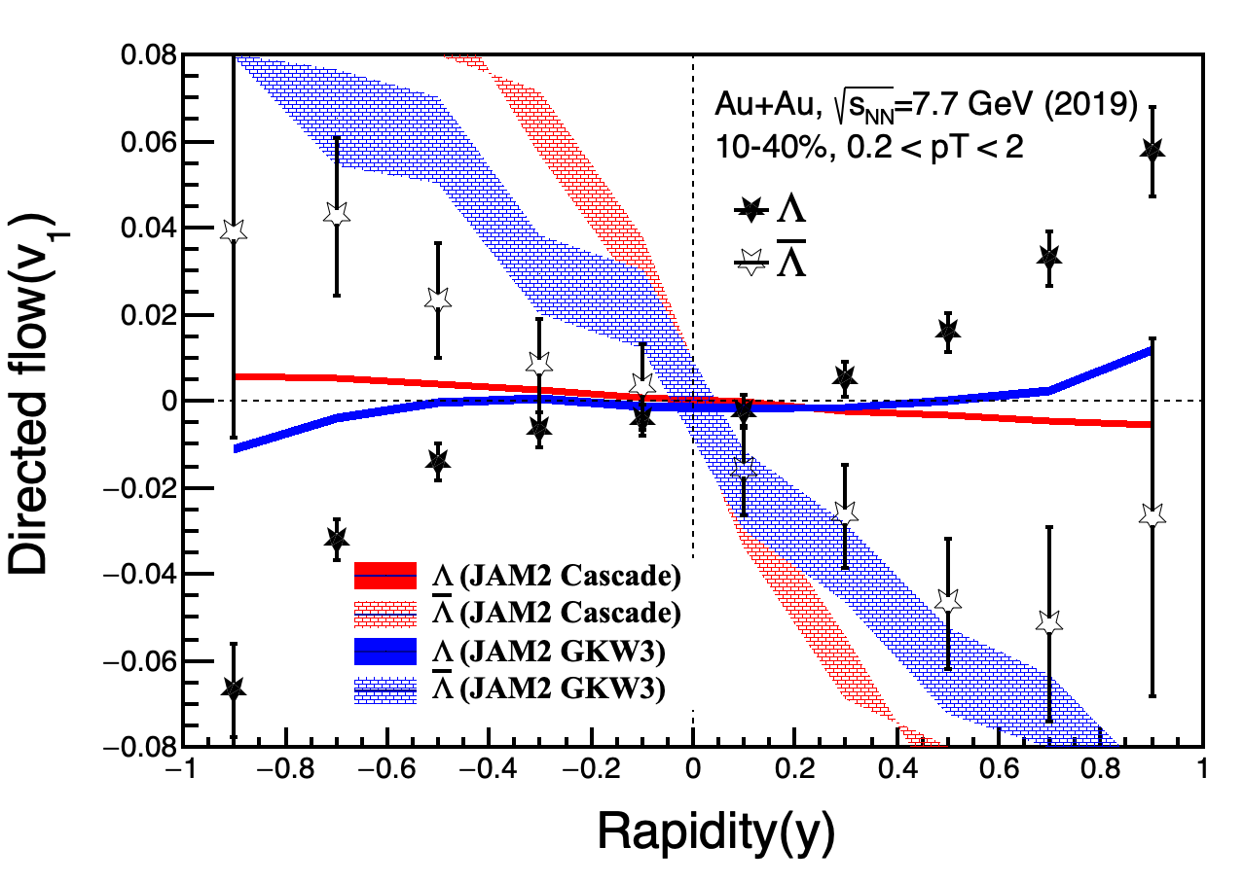
w/o lambda potential
w/ lambda potential
Can not reproduce the author’s results: arXiv:2208.01297v2

Slide 17
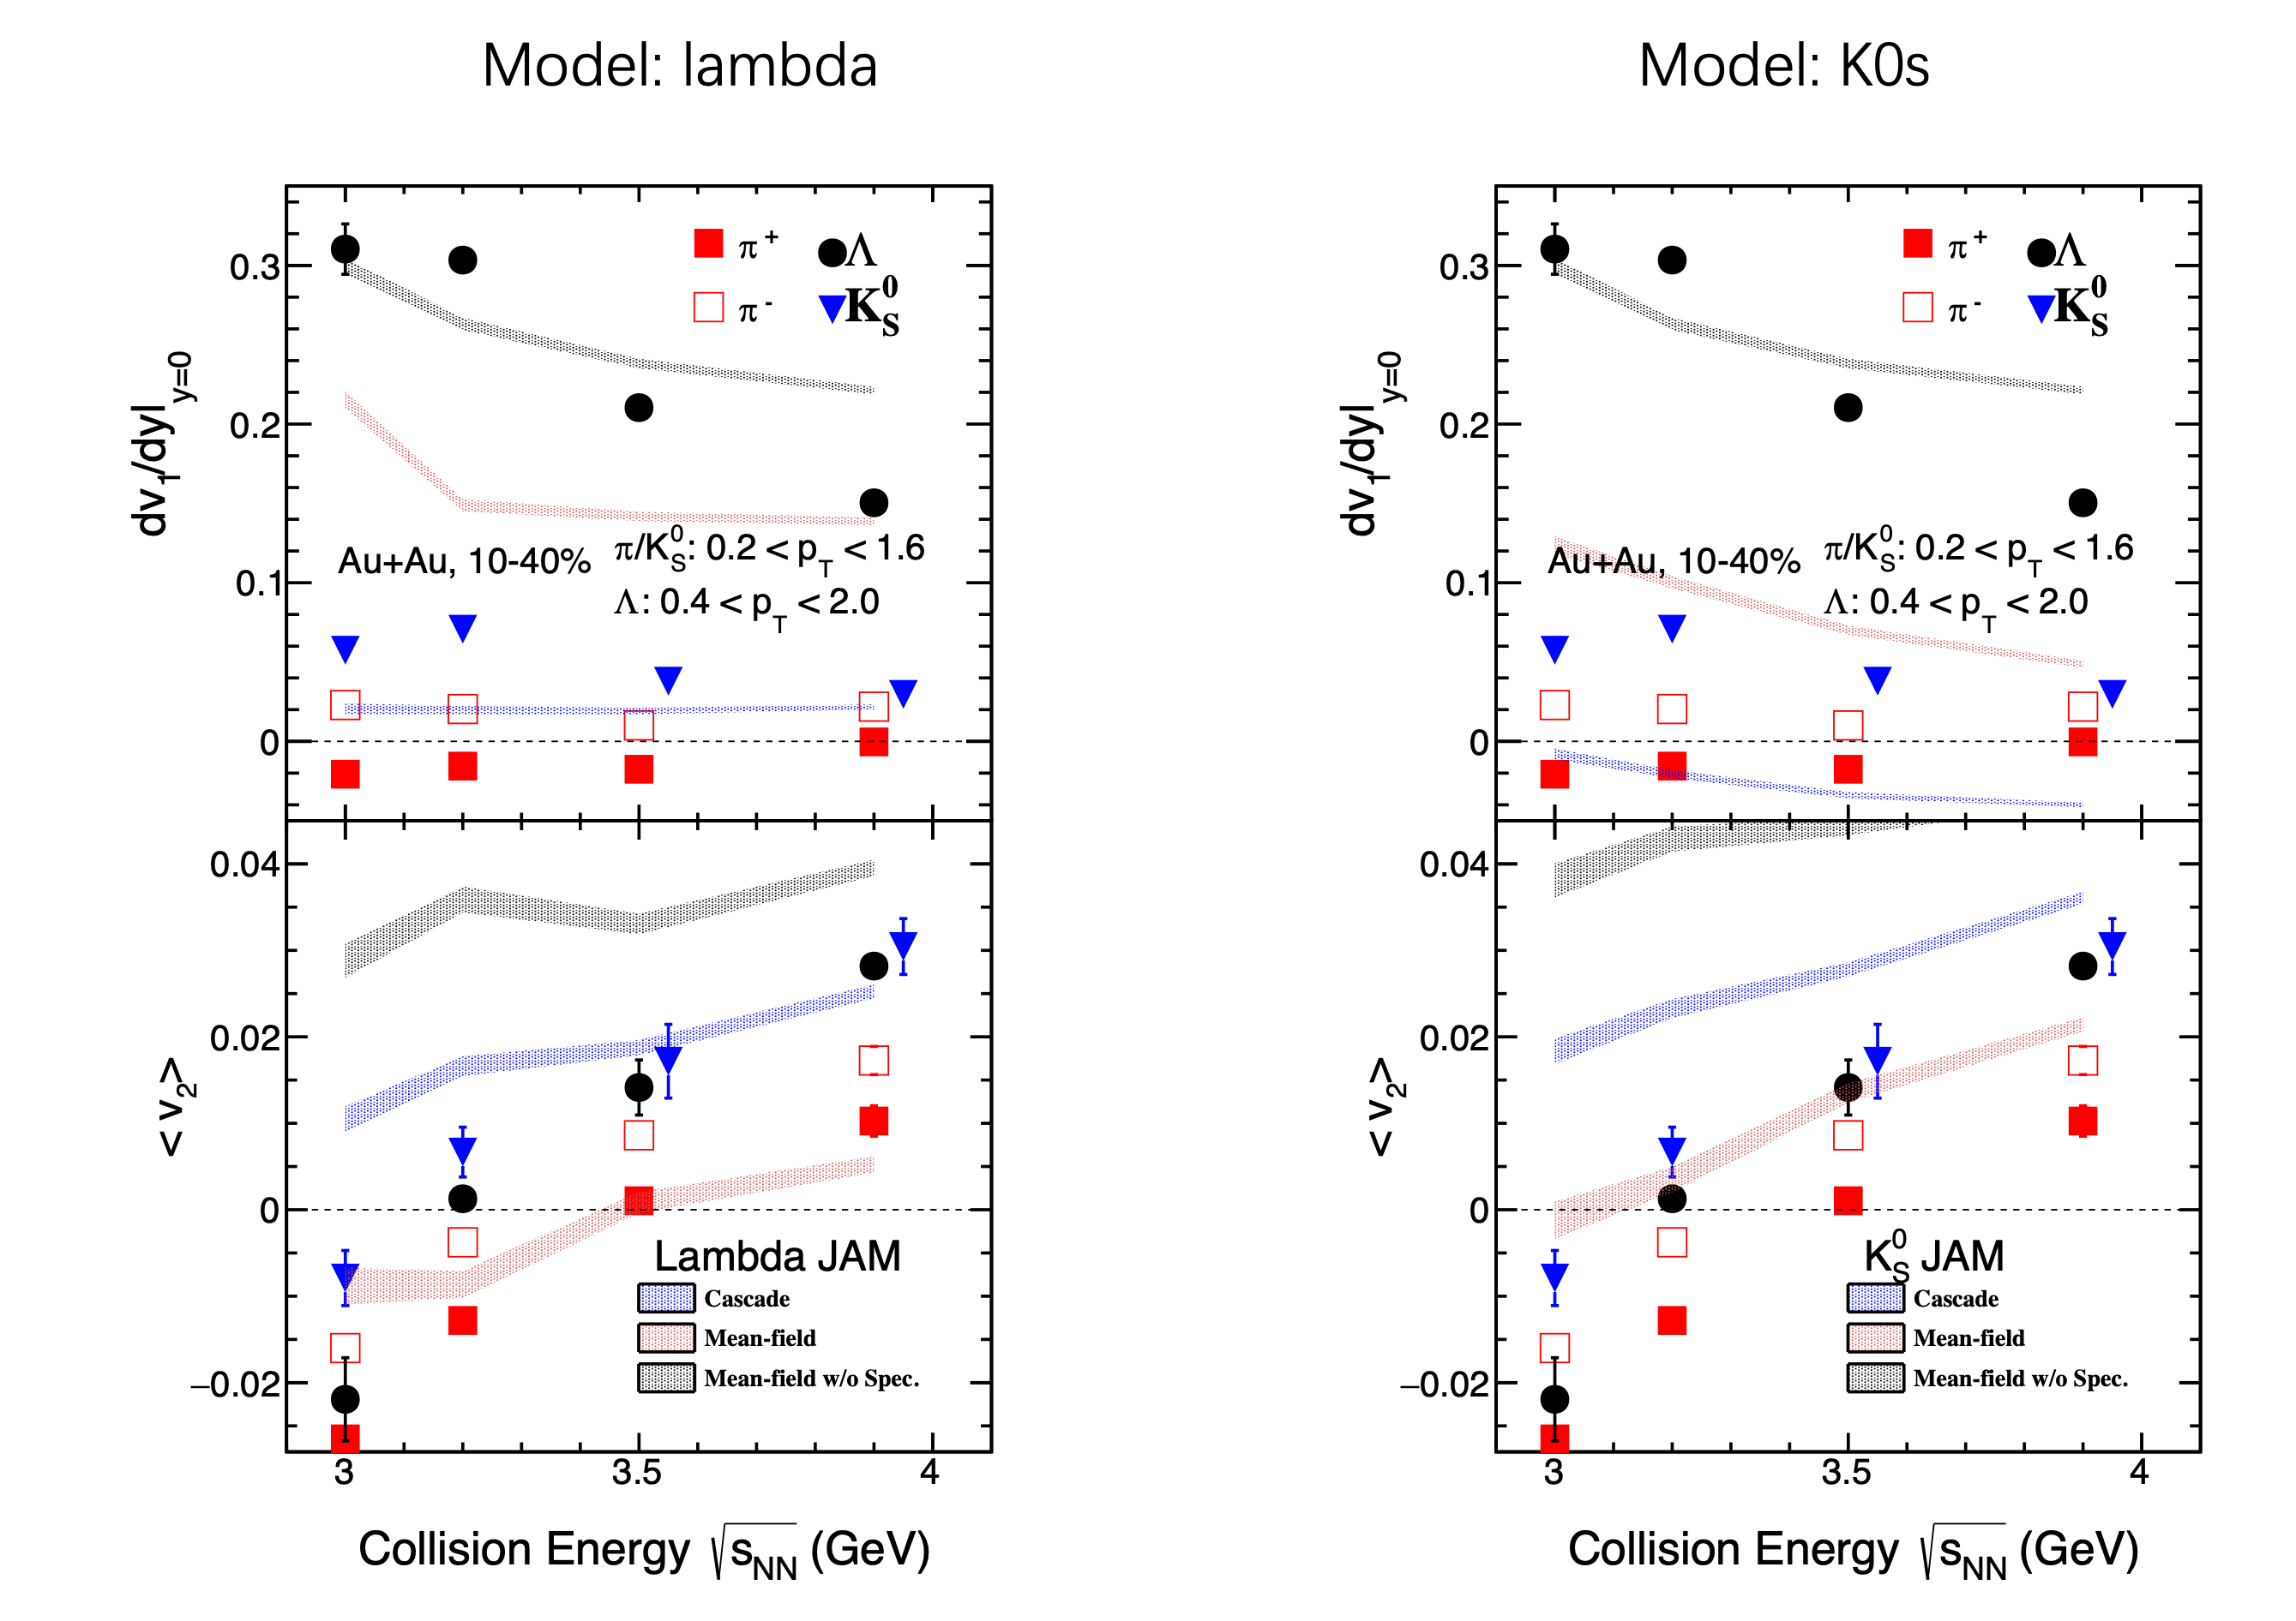
Mean-field: RQMD/RMF

Slide 18
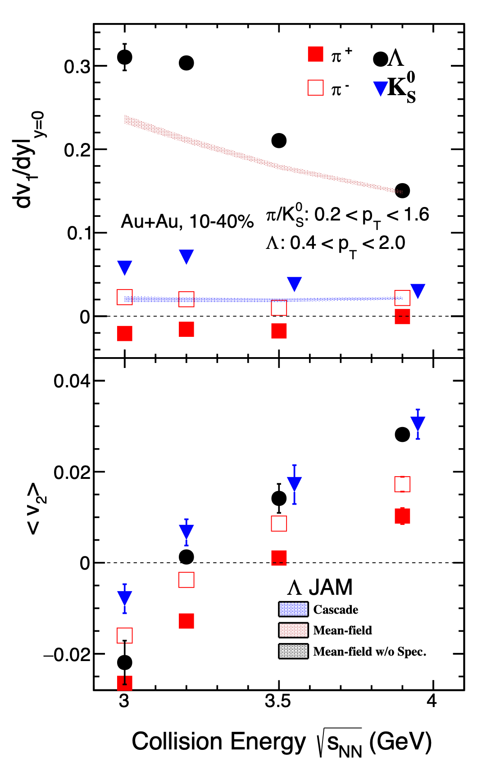
Model: lambda
Better description with RQMDv/MS2 than RQMD/RMF
Mean-field: RQMDv/MS2

Slide 19
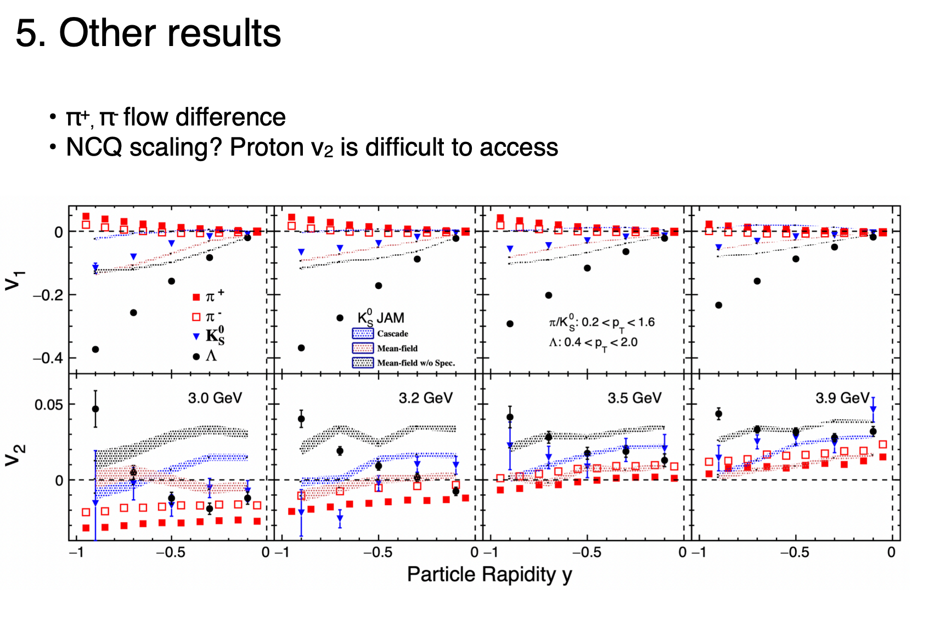
Question 5
As follow
Acceptance issue, I think we should not show proton and charged kaon results until ETOF calibration finished.

Slide 20
Pion v₁/v₂(y)
v1: negative slope for 𝜋⁺(u$\overline{d}$), positive for 𝜋⁻ ($\overline{u}$d) at mid-rapidity
Isospin?
v2: 𝜋⁺(u$\overline{d}$) < 𝜋⁻ ($\overline{u}$d) at mid-rapidity
Transported quark effect? (#neutron > #proton in Au)

Slide 21
Backup

Slide 22
Acceptance(Proton)

Slide 23
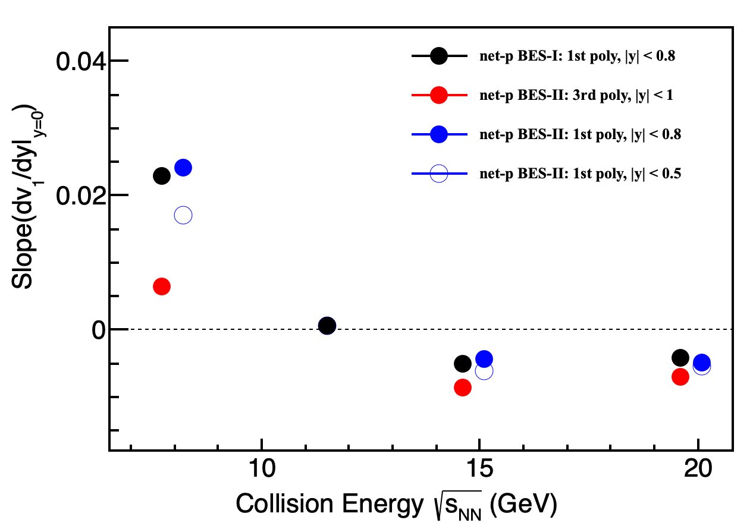
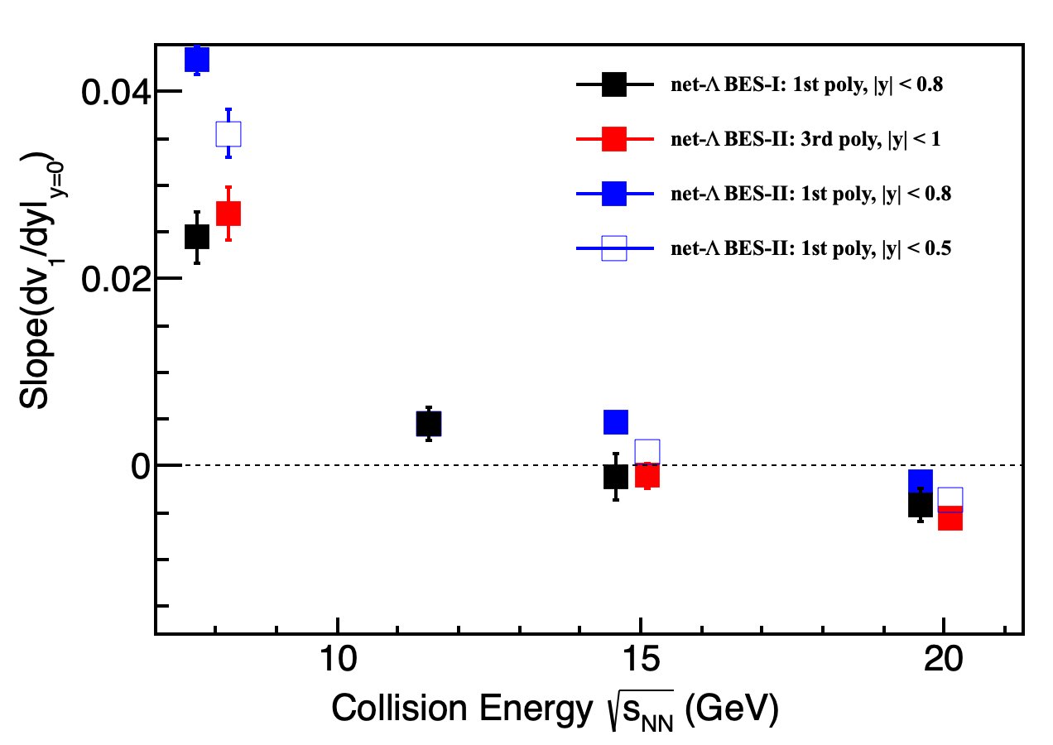
Net-p/𝛬 v₁ Slope: BES-I vs BES-II
1st order poly: v₁(y) = p₀*y
3rd order poly: v₁(y) = p₀*y + p₁*y³
Net-p v₁ slopes (BES-II) extracted by 1st order poly. function are consistent with BES-I.
Net-𝛬 v₁ slopes (BES-II) extracted by 3rd order poly. function are consistent with BES-I.
The v₁ slopes depend on the fitted rapidity range.

Slide 24
(net-)p/𝛬 v₁ Slope: BES-I vs BES-II
Fitting function:
BES-I: v₁(y) = p₀*y , |y| < 0.8
BES-II: v₁(y) = p₀*y + p₁*y³ , |y| < 1
Note: The error is statistic error only.
(net-)p/𝛬 v₁ slope shows discrepancy: BES-II vs. BES-I.
→ (1) Fitting function? (2) Fitting range? (3) New physics?(lambda potential)
Notes:
Proton and lambda from BES-I are close, while there is discrepancy based on BES-II dataset.

Slide 25
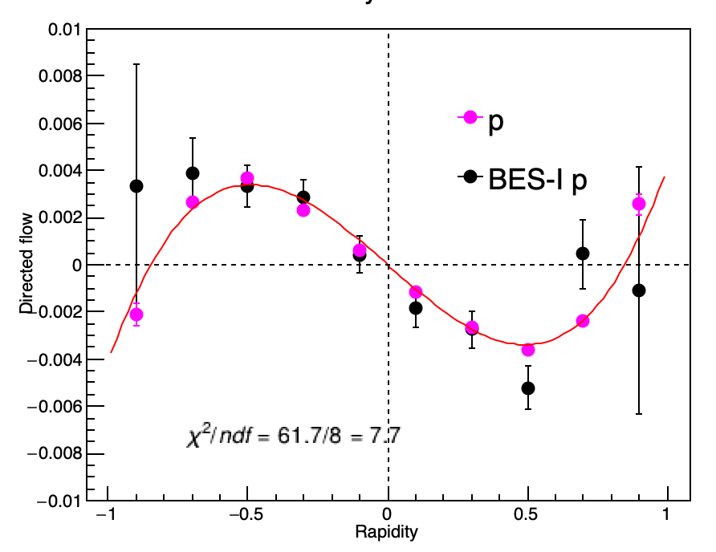
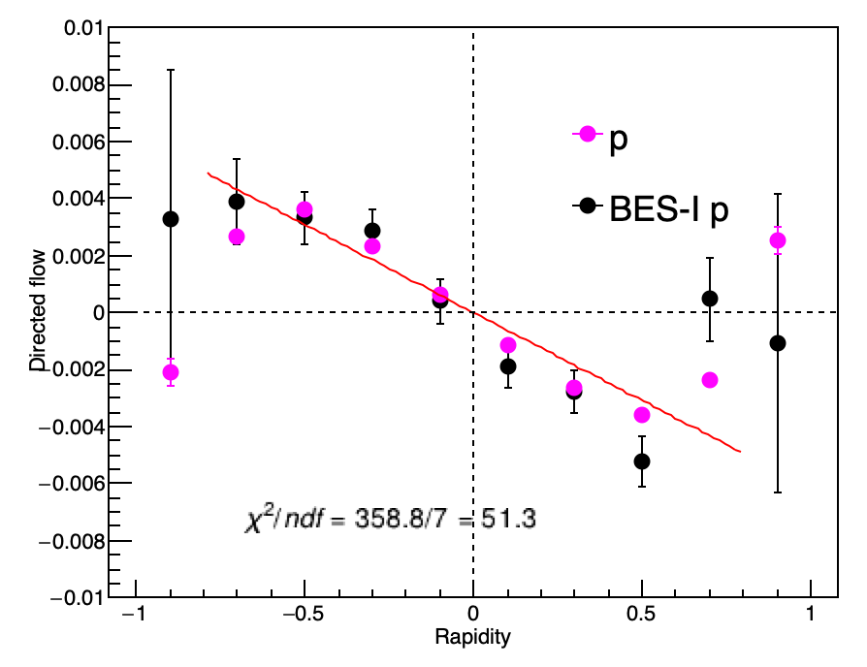
Au+Au @ 14.6 GeV, 10-40%, 0.4<p_{T}<2.0
Fitting function:
v₁(y) = p₀*y + p₁*y³, |y| < 1
Fitting function:
v₁(y) = p₀*y , |y| < 0.8
Slope = -0.010398 ± 1.98193e-04
Slope = -0.00548 ± 1.01560e-04
BES-I slope:
-0.00684062 ± 8.43574e-04
BES-I/II v₁ values are consistent, while there is obvious difference for slopes determined by different functions.
Notes:
From my site, abundant statistics from BES-II； theoretically, 3rd ploy term should be taken into consideration to describe far-rapidity data.

Slide 26
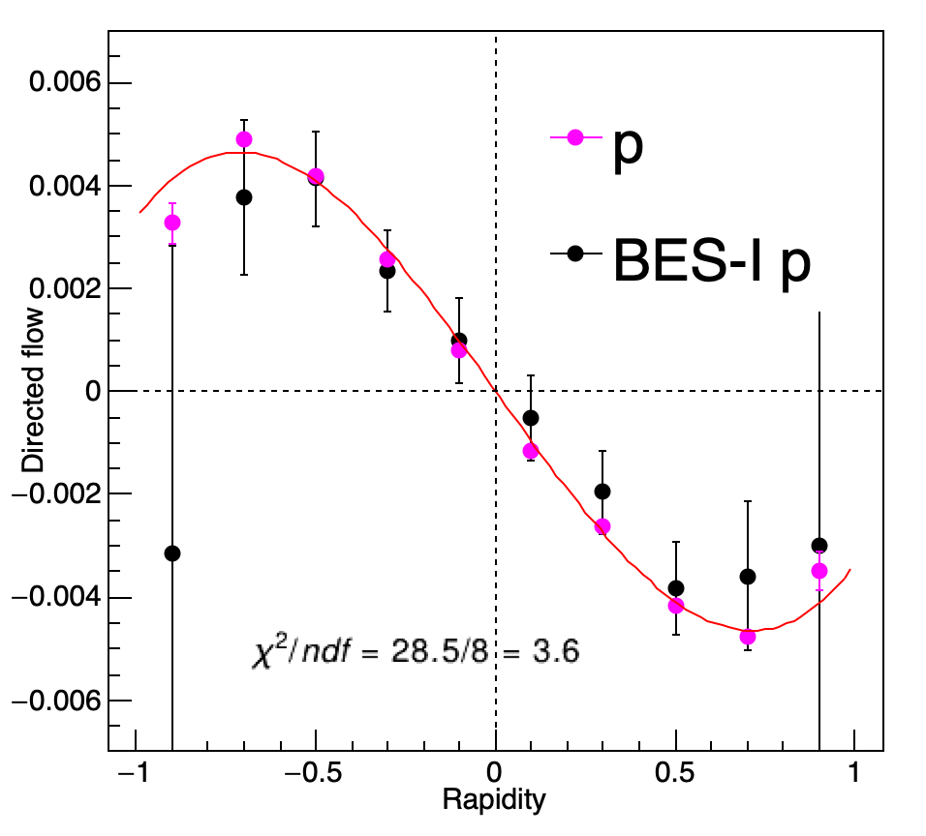
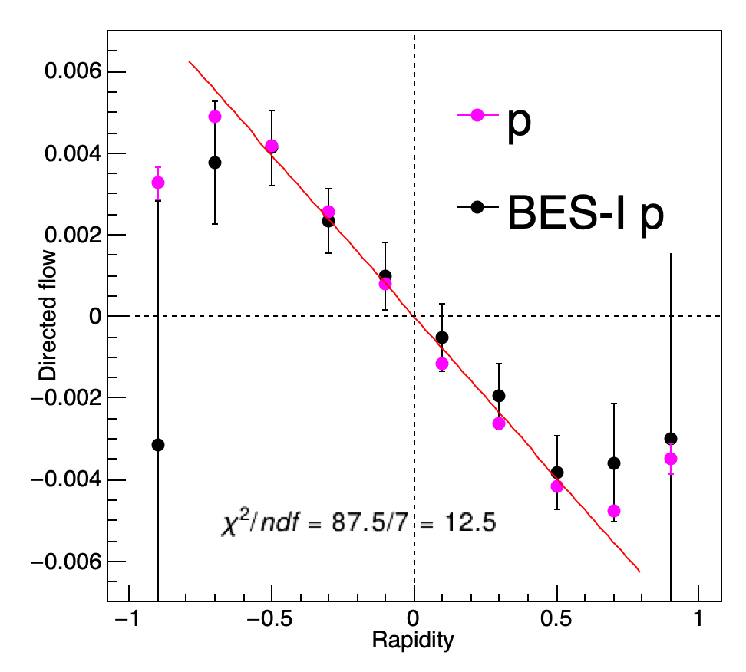
Au+Au @ 19.6 GeV, 10-40%, 0.4<p_{T}<2.0
Fitting function:
v₁(y) = p₀*y + p₁*y³, |y| < 1
Fitting function:
v₁(y) = p₀*y , |y| < 0.8
Slope = -0.00976 ± 1.66956e-04
Slope = -0.00790 ± 8.89957e-05
BES-I slope:
-0.00690107 ± 8.53584e-04
BES-I/II v₁ values are consistent, while there is obvious difference for slopes determined by different functions.
Notes:
From my site, abundant statistics from BES-II； theoretically, 3rd ploy term should be taken into consideration to describe far-rapidity data.

Slide 27
Au+Au @ 7.7 GeV, 10~40%, 0.4<p_{T}<2.0
Fitting function:
v₁(y) = p₀*y + p₁*y³, |y| < 1
Fitting function:
v₁(y) = p₀*y , |y| < 0.8
The 𝛬 v₁ from BES-I
looks asymmetric
Fitting function:
v₁(y) = p₀*y , |y| < 0.5
Fitting function:
v₁(y) = p₀*y , |y| < 0.8
Notes:
We cannot get the same slope as BES-I using the same method with BES-II data

Slide 28
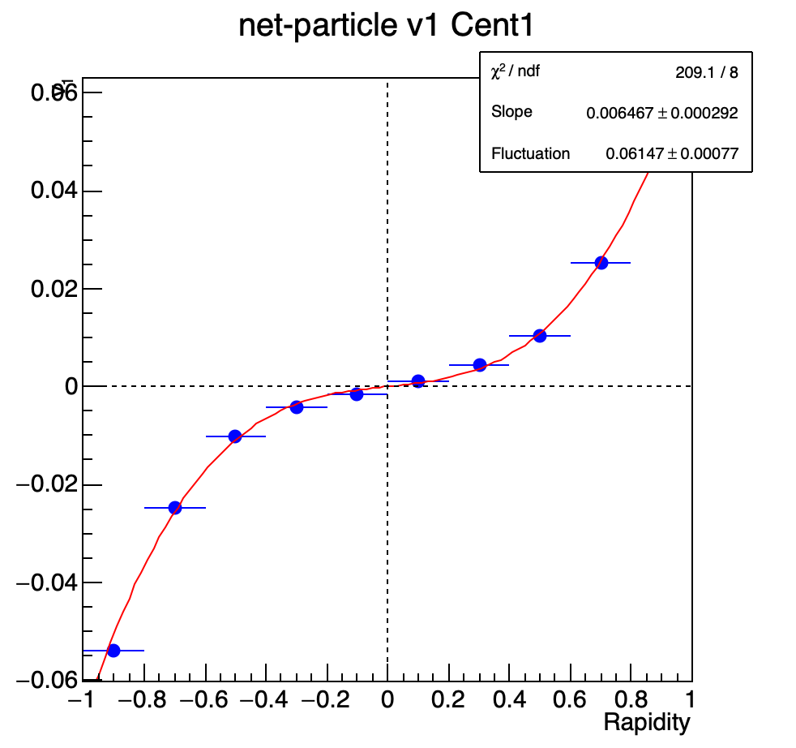
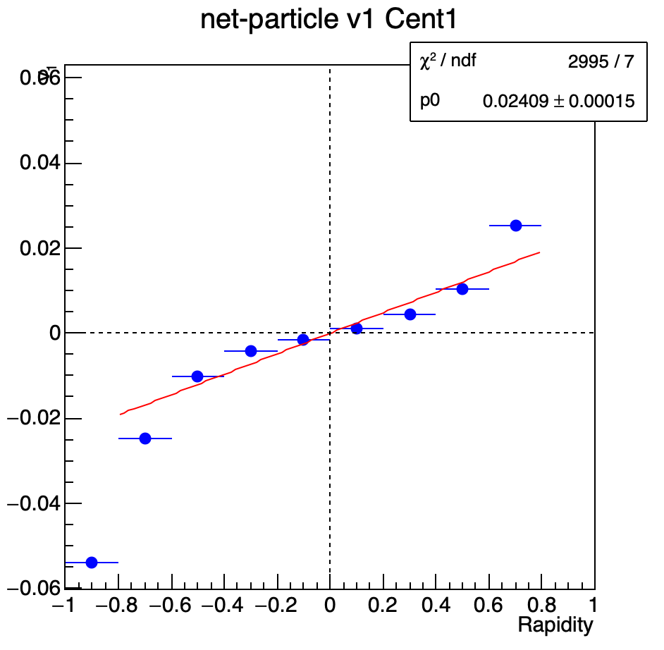
Net-proton v1 slope
Au+Au, 7.7 GeV
Slope BES-I:
0.0229±0.0009±0.0012

Slide 29
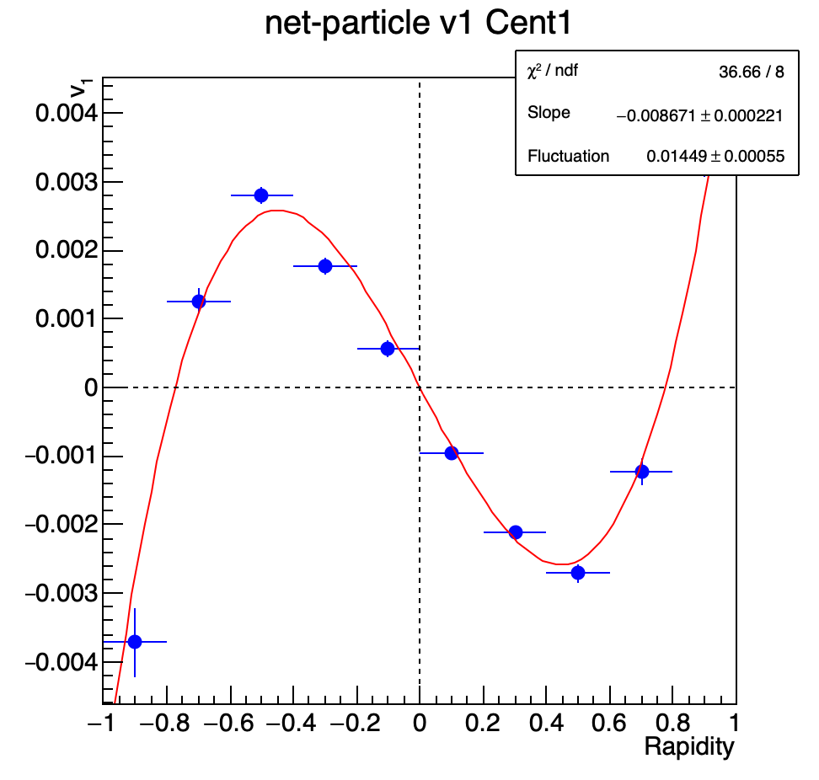
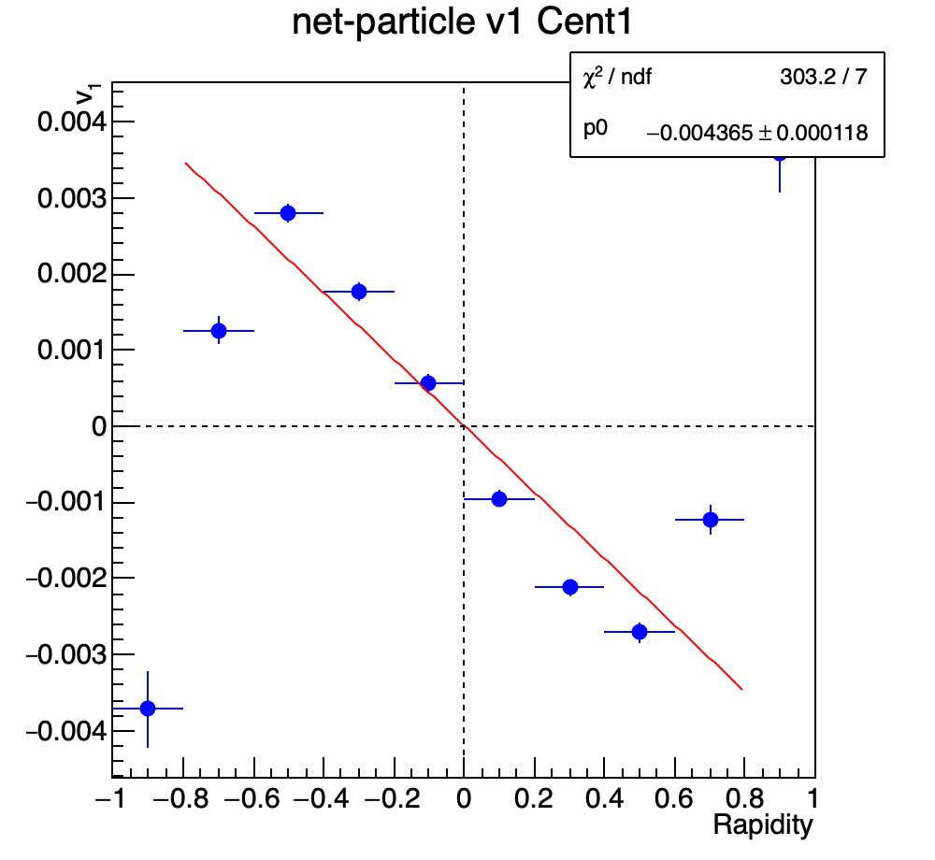
Net-proton v1 slope
Slope BES-I:
-0.0050±0.0009±0.0008
Au+Au, 14.6 GeV

Slide 30
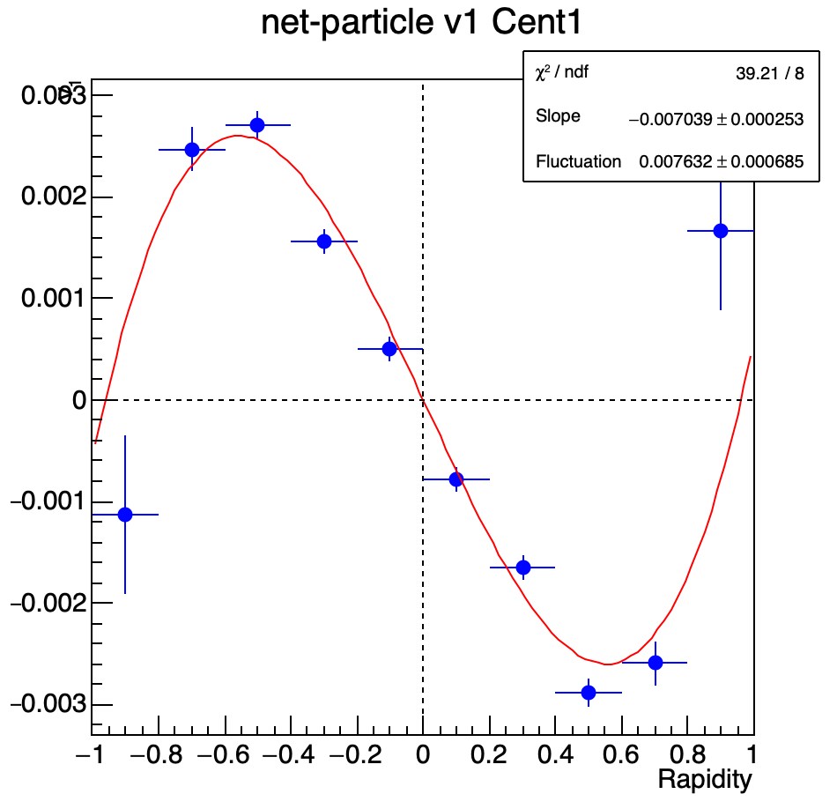
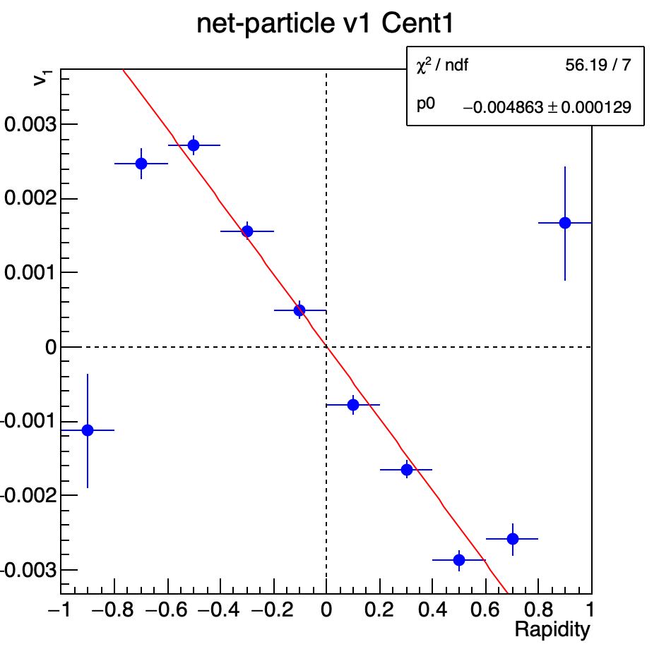
Net-proton v1 slope
Slope BES-I:
-0.0041±0.0010±0.0009
Au+Au, 19.6 GeV

Slide 31
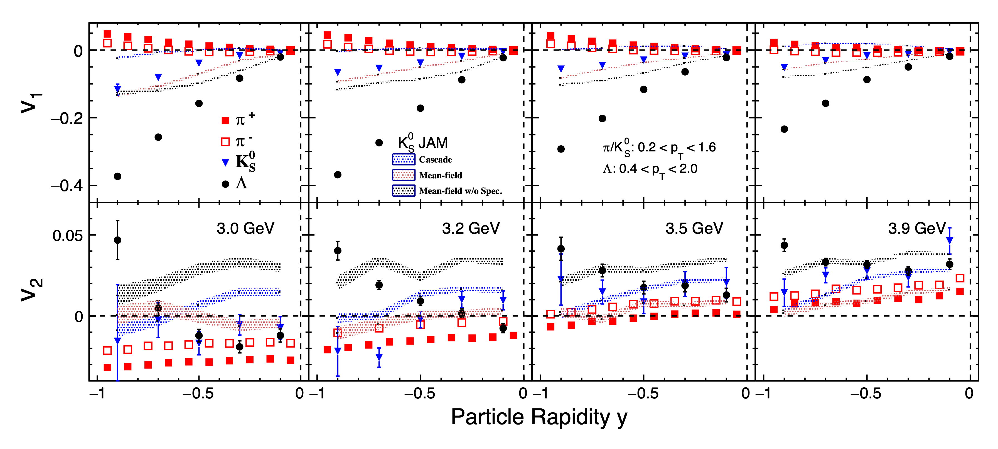
Fig. 2 (v₁/v₂ vs. y)
How to present the data and model calculations?

Slide 32
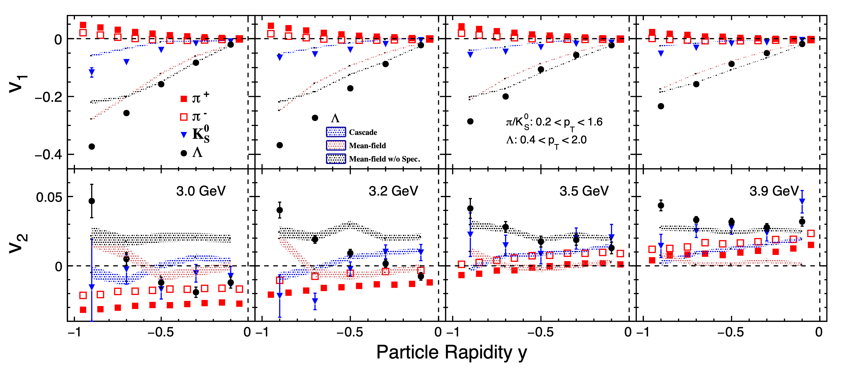
Fig. 2 (v₁/v₂ vs. y)

Slide 33
